Slide 2
define the concept of principal, rate, time, simple interest, and amount.
explore the formulae of principal, rate, time, simple interest, and amount.

Slide 3
Principal (P or p)
The total amount of money borrowed by an individual from other individual.
The money borrowed or lent out for a certain period.
The principal is the amount that initially borrowed from the bank or invested.

Slide 4
Rate of Interest (R or r)
Interest - Extra money paid for using other’s money.
Interest – Per cent.
5% or 9%

Slide 5

Rate of Interest (R or r)
Rate of interest – Percentage (R% or r% )
$\frac{ \text{R}}{\text{100}}$
$\frac{ \text{r}}{\text{100}}$
Rate of interest - 5%, 10%, or 12%, etc.

Slide 6
Rate of Interest – Fixed Period of Time
A Specified term.
Per cent of the principal.

Slide 7
Rate or Interest – Fixed Period of Time
Fixed Period - A year, six months, three months or a month.
Rate of interest - Annually, semi-annually, quarterly or monthly.
Rate of interest is 5% per annum.
Interest payable on 100 for one year is 5.

Slide 8
Time (T or t)
The duration for which the principal amount is given to someone.
A year, six months, three months or a month.

Slide 9
Simple Interest (S.I.)
If the interest on a sum borrowed for a certain period is reckoned uniformly.
When interest is payable on the principal amount only.

Slide 10
Simple Interest (S.I.)
The interest computed on the principal amount for the entire period it is borrowed.
Simple interest on Rs. 100 at 5% per annum = Rs. 5 each year.

Slide 11
Amount (A)
Principal borrowed plus the interest.

Slide 12
Basic Formulae
P or p = Principal
R or r = Rate
T or t = Number of years
S.I. or I = Simple interest
A = Amount

Slide 13
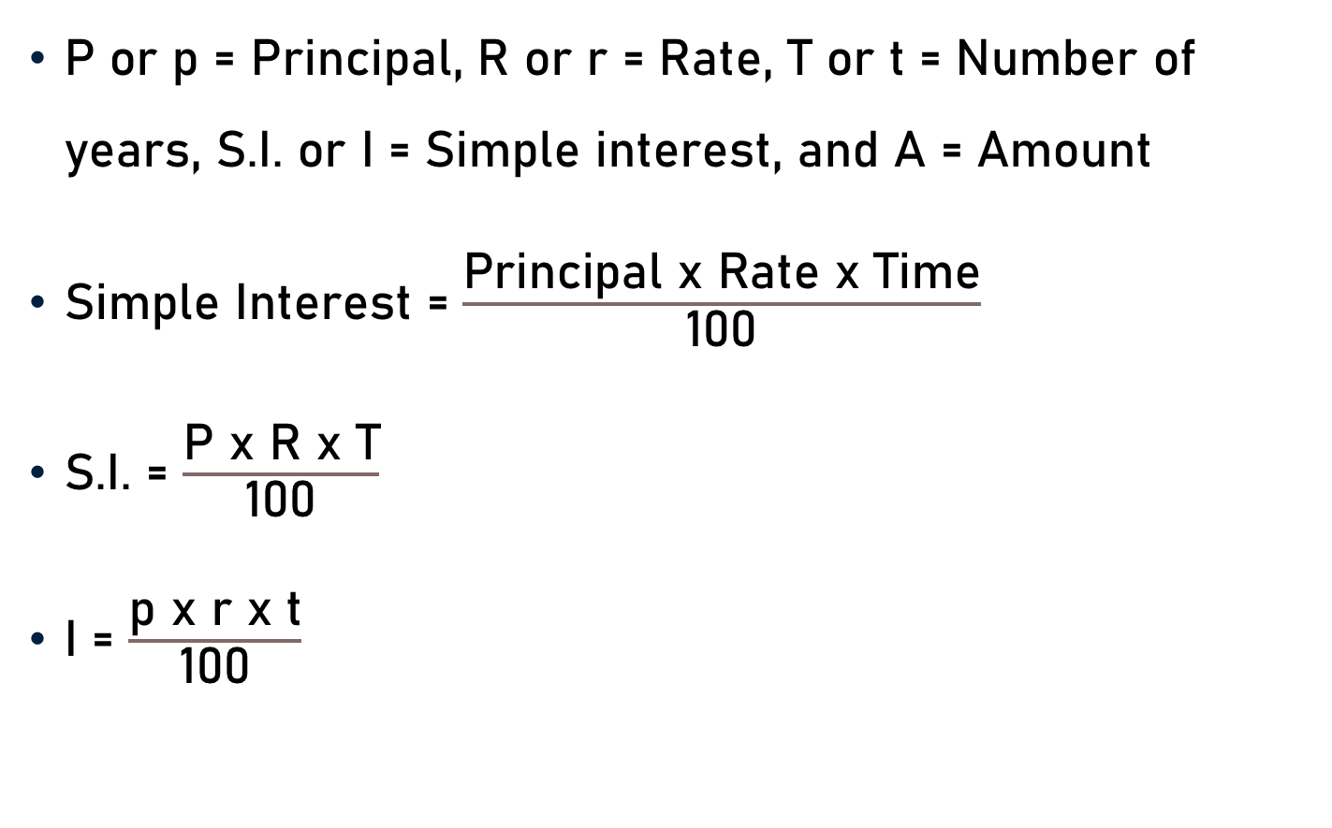
Basic Formulae
P or p = Principal, R or r = Rate, T or t = Number of years, S.I. or I = Simple interest, and A = Amount
Simple Interest = $\frac{\text{Principal} \text{x} \text{Rate} \text{x} \text{Time}}{\text{100}}$
S.I. = $\frac{\text{P} \text{x} \text{R} \text{x} \text{T}}{\text{100}}$
I = $\frac{\text{p} \text{x} \text{r} \text{x} \text{t}}{\text{100}}$

Slide 14
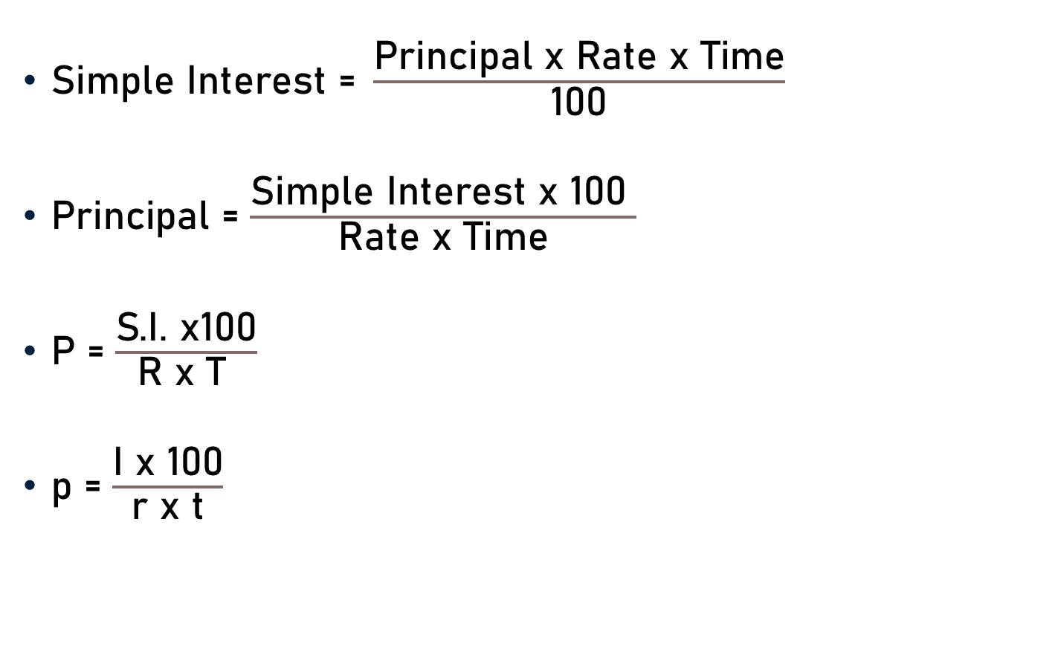
Basic Formulae
$\text{Simple} \text{Interest}\text{ = }\frac{\text{Principal} \text{x} \text{Rate} \text{x} \text{Time}}{\text{100}}$
$\text{Principal}$ = $\frac{\text{Simple} \text{Interest} \text{x}\text{ 100 }}{\text{Rate} \text{x} \text{Time}}$
P = $\frac{\text{S}\text{.}\text{I}\text{. }\text{x}\text{100}}{\text{R} \text{x} \text{T} }$
p = $\frac{\text{I} \text{x}\text{ 100}}{\text{r} \text{x} \text{t}}$

Slide 15
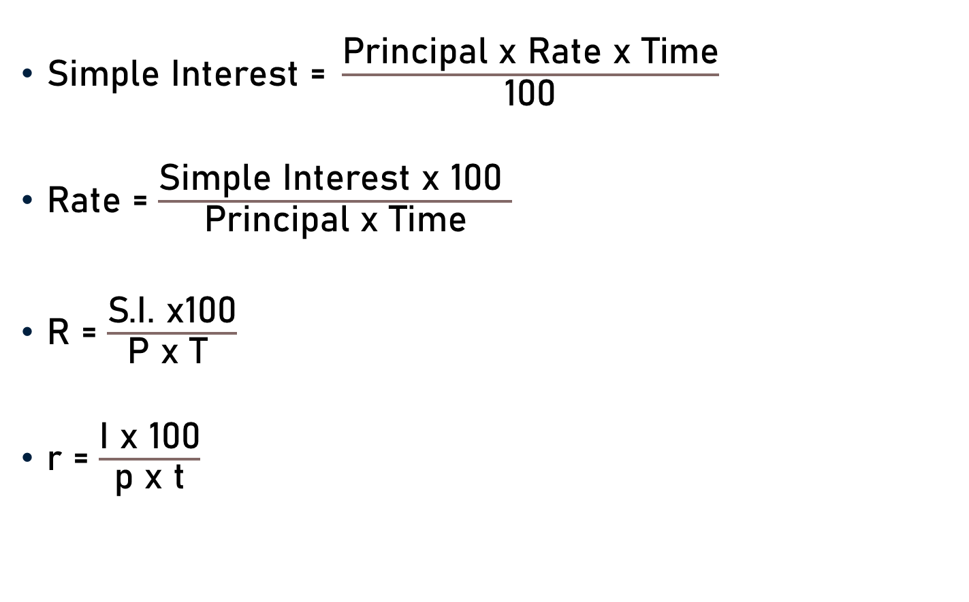
Basic Formulae
$\text{Simple} \text{Interest}\text{ = }\frac{\text{Principal} \text{x} \text{Rate} \text{x} \text{Time}}{\text{100}}$
$\text{Rate}$ = $\frac{\text{Simple} \text{Interest} \text{x}\text{ 100 }}{\text{Principal} \text{x} \text{Time}}$
R = $\frac{\text{S}\text{.}\text{I}\text{. }\text{x}\text{100}}{\text{P} \text{x} \text{T} }$
r = $\frac{\text{I} \text{x}\text{ 100}}{\text{p} \text{x} \text{t}}$

Slide 16
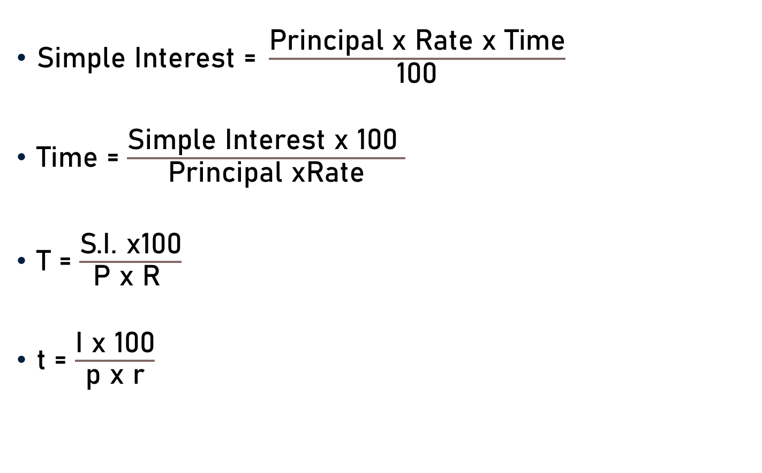
Basic Formulae
$\text{Simple} \text{Interest}\text{ = }\frac{\text{Principal} \text{x} \text{Rate} \text{x} \text{Time}}{\text{100}}$
$\text{Time}$ = $\frac{\text{Simple} \text{Interest} \text{x}\text{ 100 }}{\text{Principal} \text{xRate}}$
T = $\frac{\text{S}\text{.}\text{I}\text{. }\text{x}\text{100}}{\text{P} \text{x} \text{R} }$
t = $\frac{\text{I} \text{x}\text{ 100}}{\text{p} \text{x} \text{r}}$

Slide 17
Basic Formulae
Amount = Principal + Interest
A = P (or p) + S.I. (or I)
Principal = Amount – Interest
P = A – S.I.
Interest = Amount – Principal
S.I. = A - P

Slide 18
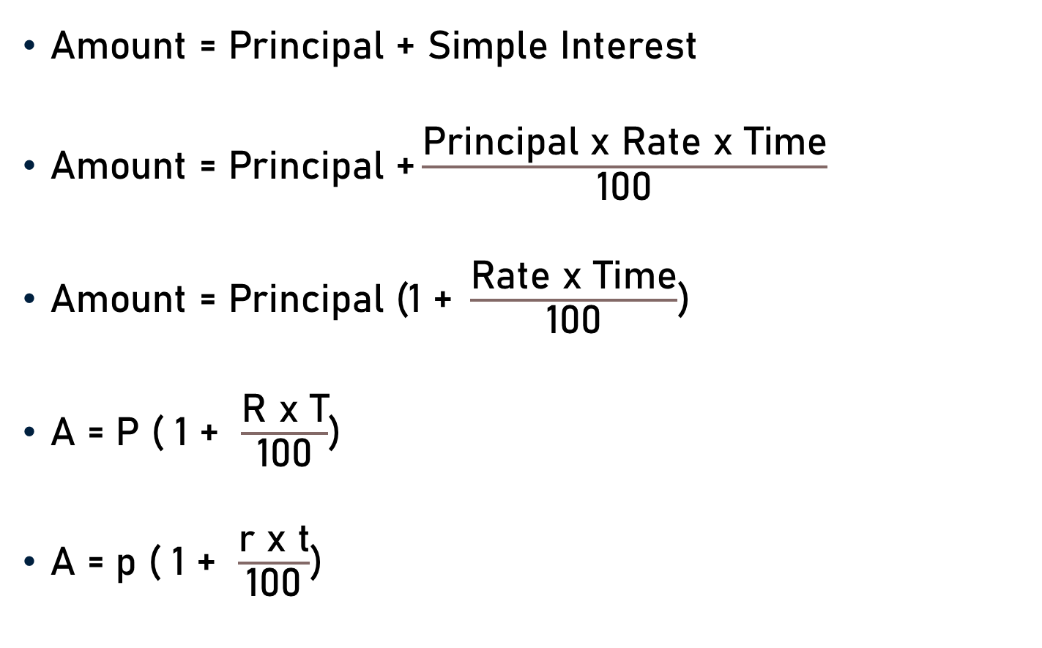
Basic Formulae
$\text{Amount}\text{ = }\text{Principal}\text{ + }\text{Simple} \text{Interest}$
$\text{Amount}\text{ = }\text{Principal}\text{ +}\frac{\text{Principal} \text{x} \text{Rate} \text{x} \text{Time}}{\text{100}}$
$\text{Amount}\text{ = }\text{Principal} \text{(1 }\text{+} \frac{\text{Rate} \text{x} \text{Time}}{\text{100}}$)
A = P ( 1 + $\frac{\text{R} \text{x} \text{T}}{\text{100}}$)
A = p ( 1 + $\frac{\text{r} \text{x} \text{t}}{\text{100}}$)

Slide 19
Conclusion
Principal - The total amount of money borrowed.
Rate or Rate of Interest – Extra Money Paid per cent.
Time - Duration for which the principal amount is given.
Simple Interest - The interest computed on the principal amount for the entire period it is borrowed.
Amount - Principal borrowed plus the interest.

Slide 20

Conclusion
Simple Interest = $\frac{\text{Principal} \text{x} \text{Rate} \text{x} \text{Time}}{\text{100}}$
Amount = Principal + Interest

Slide 21
Summary
Basic Concept and Formulaes
  Principal
  Rate or Rate of Interest
  Time
  Simple Interest
  Amount

